Slide 1

Database Query Operations for
Java
SQL & PL/SQL

Slide 2
Introduction to The SQL
SQL (Structured Query Language) is a database language, providing means of data manipulation (Create, retrieve, update, delete).
All Modern RDBMS use sql for data manipulations.

Slide 3
Continue…
SQL provide arithmetic operations like division , multiplication, subtraction & addition.
It also provides comparison operator (=,>=,<=)
And also has some aggregate functions like MAX,MIN,AVG,COUNT & SUM

Slide 4
Continue…
SQL defines several keywords for data manipulations and retrieval.
  SELECT,UPDATE,DELETE,INSERT
  COMMIT,ROLLBACK
  DROP,ALTER
SQL Commands are not case-sensitive

Slide 5
SQL Commands
SQL commands are the instructions, coded into SQL statements, which are used to communicate with the database to perform specific tasks.
Command Category | Propose of Command
DDL (Data Definition Language) | These SQL commands works on Database schema. For example CREATE, ALTER, DROP, RENAME, and TRUNCATE.
DML (Data Manipulation Language) | These SQL commands are used to deal with internal data. SELECT,INSERT,UPDATE,DELETE
TCL (Transaction control language) | These commands are used to managing the transactions. COMMIT,ROLLBACK.
DCL (Data Control Language) | These commands are used to provide security constraints GRANT,REVOKE

Slide 6
SQL Create Database
CREATE DATABASE database_name;
A database can contains one or many tables .
USE database_name; is the command to change the database

Slide 7
Create table command
The CREATE TABLE Statement is used to create tables to store data. Integrity Constraints like primary key, unique key, foreign key can be defined for the columns while creating the table.
CREATE TABLE table_name
{
column_name column_datatype;
};
Must be valid native database datatype .

Slide 8
SQL Data types
Data type | Data type description
CHARACTER (n) | Takes fixed size character string
VARCHAR (n) | Takes variable length character string.
BINARY (n) | Takes variable length binary string
BOOLEAN | Store true & false
INTEGER, BIGINT | Integer numeric numbers
Float,Decimal | Real Numbers
Date | Store dates

Slide 9
Create table Example
CREATE TABLE vehicle
{
v_number INT PRIMARY KEY,
color VARCHAR NOT NULL,
music_system VARCHAR,
mileage INT
};

Slide 10
Another approach
CREATE TABLE Vehicle
{
v_number INT ,
color VARCHAR(20) NOT NULL,
music_system VARCHAR(20),
mileage INT ,
brand VARCHAR(20) UNIQUE,
CONSTRAINT car_key PRIMARY KEY
(car_number, color)
};

Slide 11
Check Constraint
CREATE TABLE Vehicle
{
v_number INT ,
color VARCHAR(20) NOT NULL,
music_system VARCHAR(20),
mileage INT ,
brand VARCHAR(20) UNIQUE,
isCar CHAR(1) CHECK( isCar in (‘Y’,’N’)),
CONSTRAINT car_key PRIMARY KEY
(car_number, color)
};

Slide 12
SQL Alter table command
The SQL ALTER TABLE command is used to modify the definition (structure) of a table by modifying the definition of its columns. The ALTER command is used to perform the following functions.
1) Add, drop, modify table columns
2) Add and drop constraints

Slide 13
Syntax
Syntax to add a column
  ALTER TABLE vehicle ADD cost INT;
Syntax to drop a column
  ALTER TABLE vehicle DROP cost ;
  ALTER TABLE vehicle MODIFY average float;
Syntax to Rename
  Rename vehicle TO registered_vehicle ;

Slide 14
Insert Statement
INSERT INTO vehicle
Values (3035,’black’,null,12,’y’);
1) When adding a new row, we should ensure the datatype of the value and the column matches
2) Follow the integrity constraints, if any, defined for the table.

Slide 15
UPDATE & DELETE
UPDATE vehicle
SET mileage = 13
WHERE v_number = 3035;
___________________________________
DELETE FROM vehicle
where v_number=3035;

Slide 16
Select Statement
The SQL SELECT command is used to retrieve data from one or more tables.
SELECT selection_columns
FROM table_name
[ WHERE condition ]
[ GROUP BY column-name ]
[ HAVING condition ]
[ ORDER BY column-name ]

Slide 17
Simple Select Command
Select * from vehicles;
Select v_number from Vehicles;
Select brand , mileage from Vehicles;
Select brand as Car Make , mileage as Car Avg from Vehicles;
Select brand from vehicles where mileage >10;
Select DISTINCT brand from vehicles where mileage >10 AND color=‘Black’;

Slide 18
Order-By
Select * from vehicle ORDER By mileage;
Select * from vehicle ORDER By
mileage , brand;
Select * from vehicle ORDER By mileage DESC;

Slide 19
SQL Aggregate Functions
SQL Aggregate function return a single value in a table column.
Function name | Description
COUNT | Count the number of rows
COUNT (DISTINCT column-name)
SUM | Return the addition of column values
AVG | Return the average of column values
MIN | Return the min value in the column
MAX | Return the max value in the column

Slide 20
Aggregate Functions using Select
Select count(*) from vehicles where brand=‘TATA’;
Select count(DISTINCT brand) from vehicles;
Select SUM(COST) from Vehicles;
Select AVG(COST) from Vehicles;
Select Min(COST) from Vehicles;
Select MAX(COST) from VehiclesSales;

Slide 21
Group By Clause
SQL Group by statement is used together with the SQL aggregate functions.
Select ColumnName-Aggregate-Function
From table-name
GROUP BY column-name

Slide 22
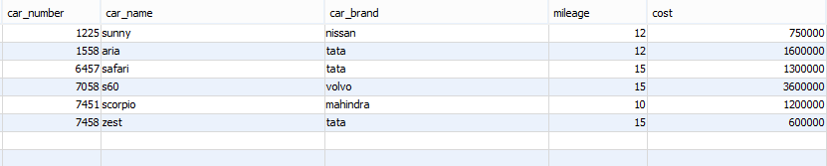
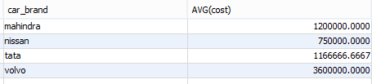
select car_brand,AVG(cost) from vehicles GROUP BY car_brand;

Slide 23
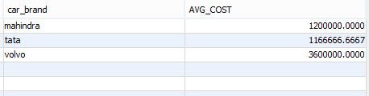
Having Clause
Having clause is used to filter data based on the group functions.
SELECT car_brand, avg(cost) as AVG_COST
from vehicles
GROUP BY car_brand
HAVING AVG_COST>800000

Slide 24
SQL Comparison Keywords
SQL has some comparison keyword which enhance the sql search capabilities.
  LIKE
  IN
  BETWEEN … AND
  IS NULL

Slide 25
Continue…
Comparison Operator | Description
LIKE | Column value is similar to specific character(s).
IN | Column value is equal to any one of a specific set of values.
BETWEEN…AND | Column value is between two values , including the end values specified in the range.
IS NULL | Column value does not exist

Slide 26
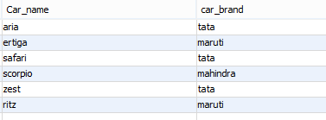
SQL LIKE operator
Use to search the content in specific pattern or when we do not know the exact searched item.
Like operator use two wildcard char % , _ .
Select car_name,car_brand from Vehicles where car_brand Like ‘_a%’ ;

Slide 27
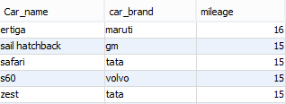
Between … AND
select Car_name,car_brand,mileage from vehicles
where mileage between 13 and 16;

Slide 28
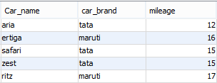
IN Clause
The IN operator is used when you want to compare a
column with more than one value
select Car_name,car_brand,mileage from vehicles
where car_brand in('tata','maruti');

Slide 29

IS NULL
A column value is NULL if it does not exist. The IS NULL operator is used to display all the rows for columns that do not have a value.
select * from vehicles where mileage is null;

Slide 30
Creation of Foreign Key
CREATE TABLE Driver
{
// some entries
vid int ,
FOREIGN KEY(vid)
REFERENCES VEHICLES (v_number)
};

Slide 31
SQL SUB-QUERY
Subquery or Inner query or Nested query is a query in a query.
SQL subquery is usually added in the WHERE Clause of the SQL statement.
Subqueries are an alternate way of returning data from multiple tables.

Slide 32
Continue…
A subquery is a query within a query
Subqueries enable you to write queries that select data rows for criteria that are actually developed while the query is executing at run time.

Slide 33

Query : looking for all records of min mileage cars
select * from vehicles where mileage = 8;
select * from vehicles where mileage = (select min(mileage) from vehicles);

Slide 34
SubQuery Types
.
  Sub Query using IN,ALL,ANY keyword usually return group of value from the same column.
  Sub query use operators (=,<,>) returns single value.

Slide 35
Sub query General Rule
A subquery SELECT statement is very similar to the SELECT
statement used to begin a regular or outer query.
    ( SELECT [DISTINCT] subquery_select_argument
    FROM {table_name | view_name}
    {table_name | view_name} ...
    [WHERE search_conditions]
    [GROUP BY aggregate_expression]
    [HAVING search_conditions] )

Slide 36
Continue…
The SELECT clause of a subquery must contain only one expression, only one aggregate function, or only one column name.
The value(s) returned by a subquery must be join-compatible with the WHERE clause of the outer query.

Slide 37
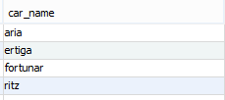
Example
select car_name from vehicles
where car_number IN(select carnum from driver where exp > 8);

Slide 38


Tables and Relation
Foreign Key

Slide 39
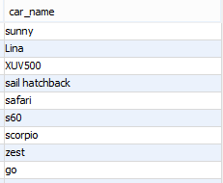
Execute Query Again
Check the presence
select car_name from vehicles
where car_number IN (select carnum from driver where exp > 8);
select car_name from vehicles
where car_number NOT IN (select carnum from driver where exp > 8);
Check the absence

Slide 40

ALL & ANY Keywords
select drivername, driverid, licensetype
from driver
where carnum IN (
select car_number
from vehicles
where cost > ALL(
select cost
from vehicles
where car_brand='mahindra'
)
);
ANY result is same as
xyz Query >= ALL

Slide 41
PL-SQL
PL-SQL is the combination of SQL and the procedural features of programming languages.
It is developed by oracle.
PL-SQL is the block structured language.
Statements end with “ ; “.

Slide 42
Basic Syntax Structure
DECLARE
<declarations section>
BEGIN
<executable command(s)>
EXCEPTION
<exception handling>
END;

Slide 43
Simple PL-SQL Statement
DELIMITER //
CREATE PROCEDURE doInsertion
(pid int,cname varchar(40),cou varchar(40),amt int,coun varchar(40))
BEGIN
IF amt<100 then
insert into project values(pid,cname,cou,null,null);
ELSE
insert into project values(pid,cname,cou,amt,coun);
END IF;
END//
DELIMITER ;

Slide 44
String comparison
IF course = ‘java’ Then
retest = 6;
Else
retest = 3;
END IF;

Slide 45
Variable Declaration
DECLARE
max_value INT;
BEGIN
max_value := 22;
END;

Slide 46
Switch Case
CREATE PROCEDURE doStuff(weight int)
DECLARE
x int;
Begin
x := weight/2;
CASE x
WHEN 10 THEN
call procedureA();
WHEN 20 THEN
call procedureA();
END CASE;
End ;

Slide 47
For Loop
Use
REVERSE
keyword
After IN for reverse iteration.
DECLARE
limit int := 10;
BEGIN
FOR i IN 1.. limit LOOP
insert into XYZ values(----);
END FOR;
END;
By default, the loop iterates in the upward fashion from the lower_bound to the higher_bound

Slide 48
END OF QUERY EXECUTION

